Slide 1
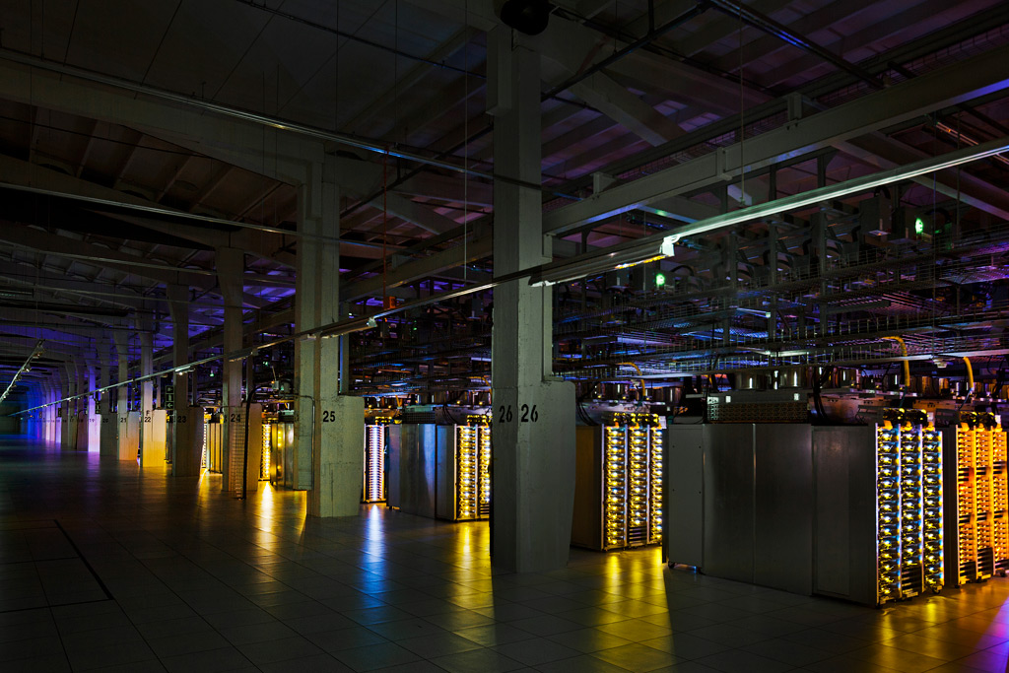
Data Center Networking
Large scale data management in the era of the Cloud
Robert Kruzel ECE 5650 Fall 17
Photo: Google Data Center, Finland

Slide 2
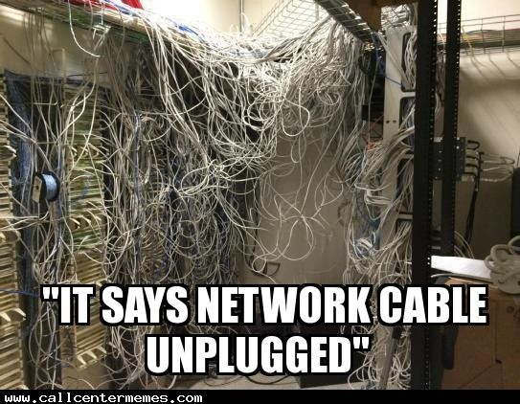
What is a Data Center Network?
Common Network Structures
Interconnection layout
Strengths and Weaknesses
Performance
Scalability
Typical Applications
The Future of Data Centers
Conclusion/Q&A
Photo: callcentermemes.com

Slide 3
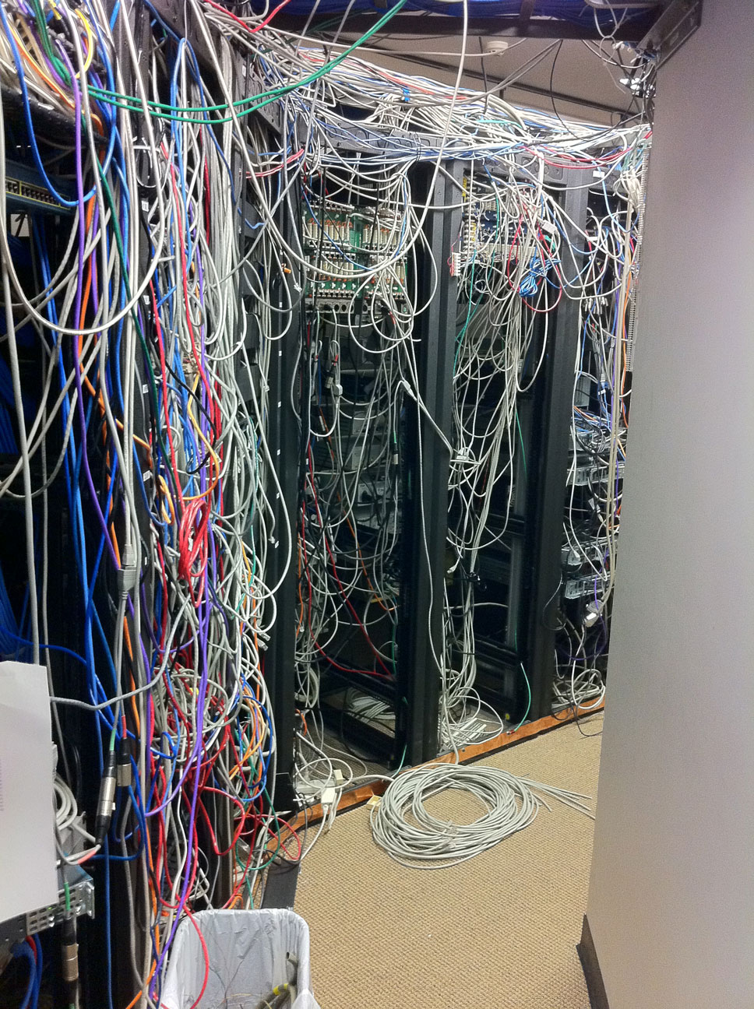
What is a Data Center Network?
Management System of a Data Center
Interconnects Resources (servers, switches, etc.)
Allows Scaling
Manages Efficiency
Responds to Device Failure
Most Common Interconnection Configurations:
Three-Tier
Fat Tree
DCell
Photo: Google image search

Slide 4
Three-Tier Networking
Most Common Architecture
Three Layered (multi-root) Tree Configuration
Layers:
Top: Core Layer -> Internet
Middle: Aggregate Layer
Bottom: Access Layer -> Servers
Aggregate Layer Switches Interconnected by Core Layer Switches
Access Layer Switches Interconnected by Aggregate Layer Switches.

Slide 5
Three-Tier Networking
Strengths:
Simple Concept
Widely Used
Weaknesses:
Subscription Imbalance between Layers
Low Scalability
Imprecise Fault Tolerance/Detection
Network Devices on Core Level (expensive cost and energy)
Requires High Local Bandwidth

Slide 6
Fat Tree
Revision of Three-Tier
Designed to Improve Oversubscription handling and reduce local Bandwidth
Integrates Clos (circuit switching)
Same 3 Levels as Three-Tier
Greatly Increased Switches/Level
Switches grouped into Pods within Level
Number of Switches/Pod dependent on number of Pods
Has Custom Addressing and Routing Algorithms.

Slide 7
Fat Tree Networking
Strengths
Reduces oversubscription and more optimally uses bandwidth available.
Clos circuit switching improves response in persistent applications.
Weaknesses
Scalability/Efficiency issues persist from Three-Tier.
Number of Pods cannot exceed number of physical Ports on switch in Level above.

Slide 8
DCell Networks
Modern Architecture
Further Addresses Weaknesses in Legacy Data Center Networks
Connects Servers to Servers Locally
Servers with Network Interface Cards replace most Switches.
Network is organized recursively.
Servers are Grouped into Cells, differentiated via a subscript: Cell₀, Cell₁, Cell₂, etc.
Cell₀ is the building block unit, Cell₁ is a group of Cell₀ units, etc.
Can be expanded to manage many servers, with few levels of Cells.

Slide 9
DCell Networks
Strengths
Great Scalability
Robust Fault Detection/Handling
Weaknesses
Weak cross section bandwidth
Latency more significant

Slide 10
Energy Consumption
Data Centers use a lot of power daily.
It is also expensive to keep servers cool (air conditioning and fluid piped cooling methods).
Modular sizing of active devices/components allows better management of our systems to reduce waste.

Slide 11
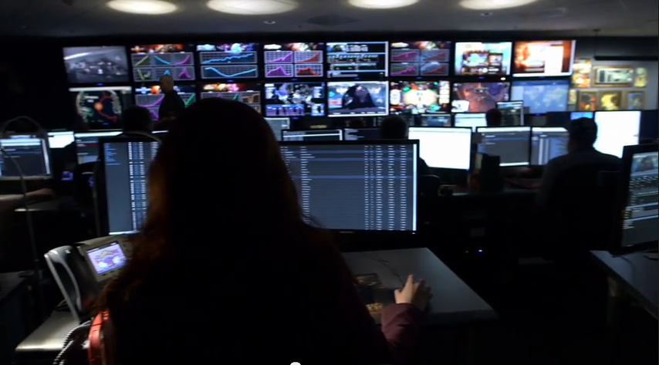
Energy Solutions Going Forward
Employ diligent staff to manage the server farm.
Upgrade routing/switching components from “Commodity” level devices, to “Workload” level devices.
New structures should be built with efficiency as a top priority.
Manage facilities layout and operation to reduce waste.
Source: Blizzard Entertainment

Slide 12
Converting Networks to Cloud Services
Cloud-based applications vs Traditional web-enabled applications.
Paradigms shift, consumer demands dictate our design process.
User experience cannot be sacrificed.
Service Providers must reduce cost/overhead to be competitive
Engineers must continue to improve the efficiency of network devices.
We must continue to be flexible and adapt to emerging technologies.

Slide 13
Conclusion
“Tomorrow, todays technology will be yesterday’s.”
Closing Thoughts
Q&A

Slide 14
Sources
On the Characterization of the Structural Robustness of Data Center Networks
http://sameekhan.org/pub/B_K_2013_TCC.pdf
On the Connectivity of Data Center Networks
http://sameekhan.org/pub/M_K_2013_CL.pdf
Quantitative comparisons of the state-of-the-art data center architectures
http://sameekhan.org/pub/K_K_2013_CCPE.pdf

